Slide 1
INSTRUCTIONS
Use Font size 22 to 28 and Font Style Times New Roman (body)
Do not change the Template: Heading / Title of the slides
Do not change font style or colours
Do not copy paste paragraphs: use only Bullet Points
Maximum slide Limit is 20 only
As per the number of supervisor allotted adopt slide-2 or slide-3
Please display the required meaningful Content or images or tables
Change the footer accordingly using insert tab then click on header & footer tab and edit it
Save the PPT with Register No, Dept and Review no, example: 23xxxxxxxxx_CSE

Slide 2

Title: PROPERTY PRICE TREND AREA INSIGHTS
Student Name: N.KARTHIK RAM PRASAD
Student ID: 2520040046
Cluster:03
Section: 11
Under the Guidance
of
Supervisor Name: RAKESH
Assistant Professor
Department of CSE

Slide 3
OUTLINE
Abstract
Existing System
Proposed System
System Architecture
Project Modules
Objectives
Co’s Attainments - FWD
Co1
Co2 …….. 5. Co5
Co’s Attainments - DSA
Co1
Co2 …….. 5. Co5
Screen Shots for FWD & DSA
Conclusion
Geo-Tagged Photos

Slide 4
Abstract
Property Price Trend Area Insights is useful for understanding how real estate prices change across different locations and over time. By examining price trends, users can identify which areas are experiencing growth, which remain stable, and which are becoming more affordable. This information helps home buyers choose suitable locations within their budget and enables investors to identify areas with high return potential. It also helps real estate agents and planners understand market demand and development patterns.

Slide 5
Existing System
In the traditional real estate system:
Property price information is scattered across different websites.
Users must manually compare prices between locations.
Market trend analysis is difficult for normal users.
No centralized platform to view area growth, demand, infrastructure ratings, and investment potential.
Data visualization is limited.

Slide 6
Proposed System
It helps users understand market growth patterns by displaying historical and current property price data.
The system enables users to identify high-growth areas that may provide better investment opportunities.
It provides detailed information about each area, including price range, demand level, and growth rate.
The application allows users to visually analyze data through charts and graphical representations, making the information easy to understand.
The system supports area comparison, helping users evaluate multiple locations before making decisions.
It highlights important market insights and trends, helping users understand the current condition of the real estate market.
The system improves decision making for buyers and investors by presenting property data in an organized way.
It reduces the time required for property market analysis by providing all necessary information in one place.

Slide 7
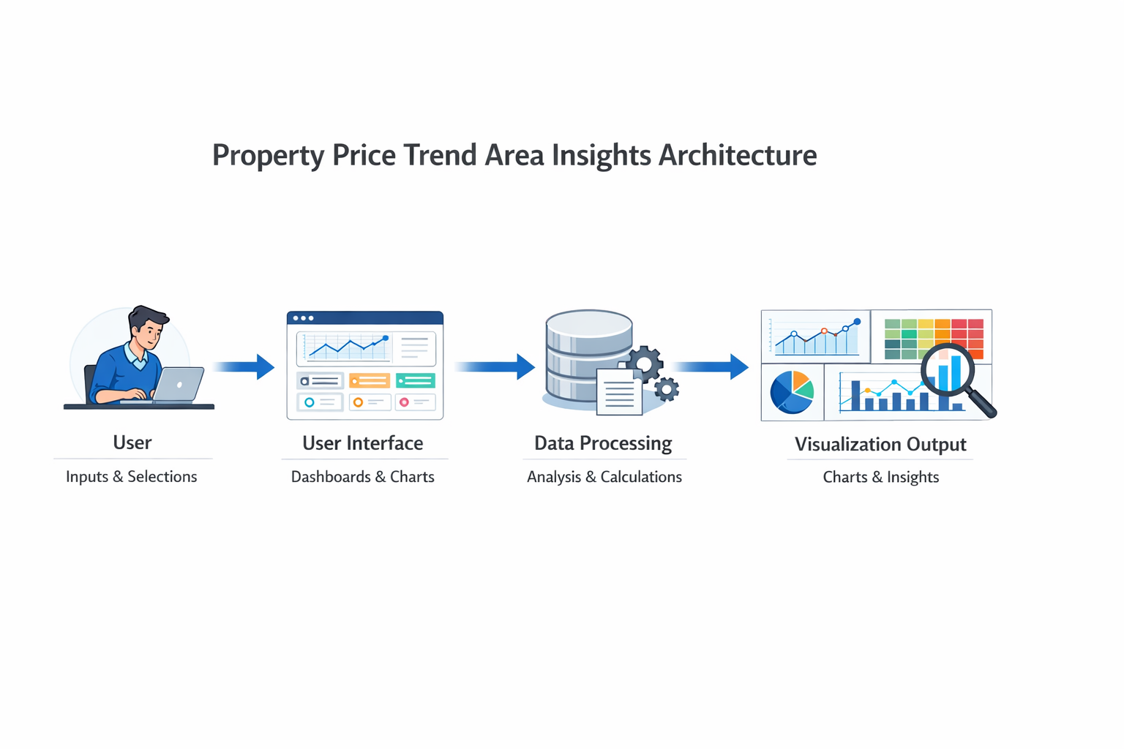
System Architecture

Slide 8
Project Modules
1. Overview Module
Displays the overall property market statistics such as average price and market growth rate.
Provides a summary dashboard with important real estate information.
Uses charts and cards to present market data clearly to the user.
2. Price Trend Analysis Module
Analyzes property price changes over different time periods.
Allows users to filter data based on area, property type, and time period.
Displays visual graphs like bar charts and doughnut charts for better understanding.
3. Area Analysis Module
Provides detailed information about each real estate area.
Displays growth rate, average price, and property availability for every location.
Uses heatmaps and statistics to show area performance.
4. Area Comparison Module
Allows users to compare two different areas.
Shows comparison based on price, growth rate, and infrastructure.
Uses radar charts to visually compare the performance of areas.
5. Insights Module
Provides market insights and recommendations based on property data.
Identifies high-growth and investment opportunities.
Displays market performance indicators such as investment risk and buyer interest.

Slide 9
Objectives
To analyze property price trends across different areas to understand real estate market behavior.
To provide graphical visualization of property data using charts and graphs for easy understanding.
To compare different locations based on price, growth rate, and demand to help users choose the best area.
To help investors and home buyers make better decisions by providing clear real estate insights.
To identify high-growth areas that offer better investment opportunities in the property market.
To create an interactive web-based platform where users can filter, analyze, and explore property market information.

Slide 10
Co’s Attainments - FWD
CO1: The project uses HTML structure and basic CSS styling to design the web interface and display property information on the webpage.
CO2: The project implements HTML forms, semantic tags, and responsive CSS layouts to allow users to filter and view property data interactively.
CO3: The project uses JavaScript programming concepts such as functions, arrays, objects, and conditions to process and manage property price data.
CO4: The project applies DOM manipulation and event handling in JavaScript to update charts, filters, and area details dynamically based on user actions.
CO5: The project incorporates advanced web development techniques such as form validation, dynamic user input handling, and optimized webpage deployment for better performance.

Slide 11
Co’s Attainments - DSA
CO1: Apply algorithm analysis and searching techniques such as Linear Search and Binary Search to efficiently retrieve property data from the system.
CO2: Implement sorting algorithms to organize property information based on price, growth rate, and demand for better analysis.
CO3: Use List ADT and Linked List structures to store and manage dynamic property records in the application.
CO4: Implement Stack and Queue data structures to handle data processing, request handling, and expression evaluation in the system.
CO5: Apply Hashing and Priority Queue (Heap) techniques to enable fast data retrieval and ranking of top-performing property areas.

Slide 12
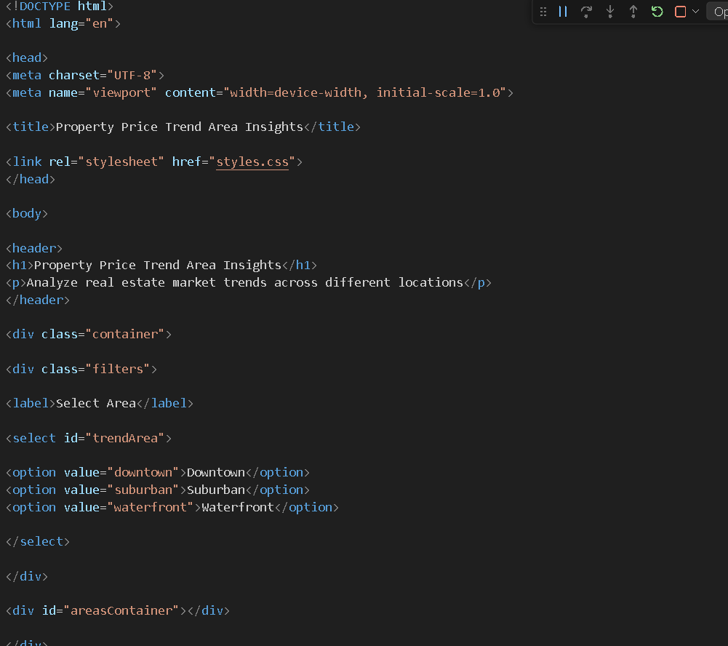
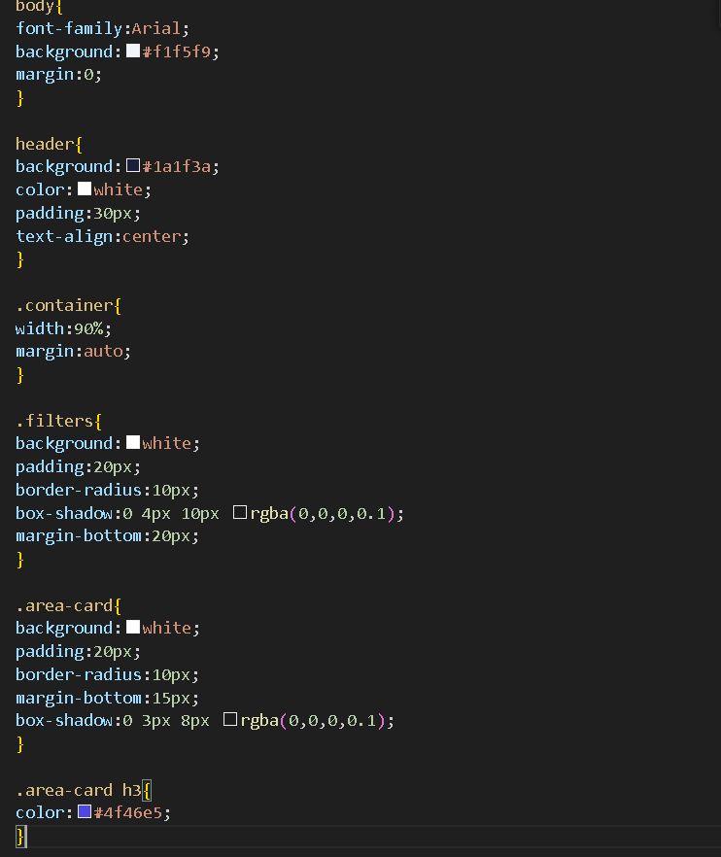
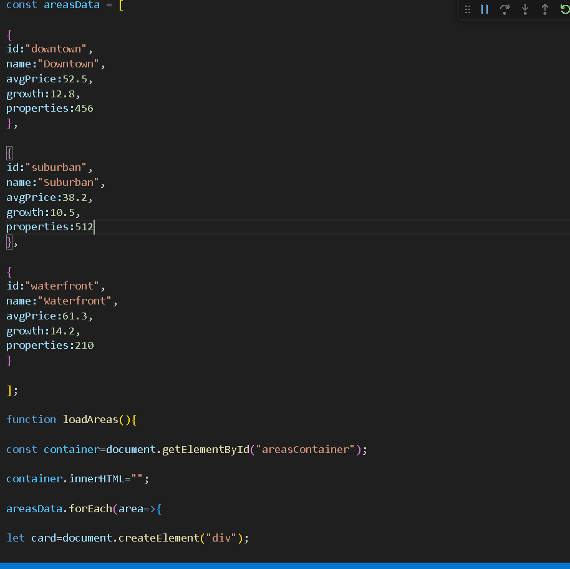
Screenshots for FWD & DSA

Slide 13
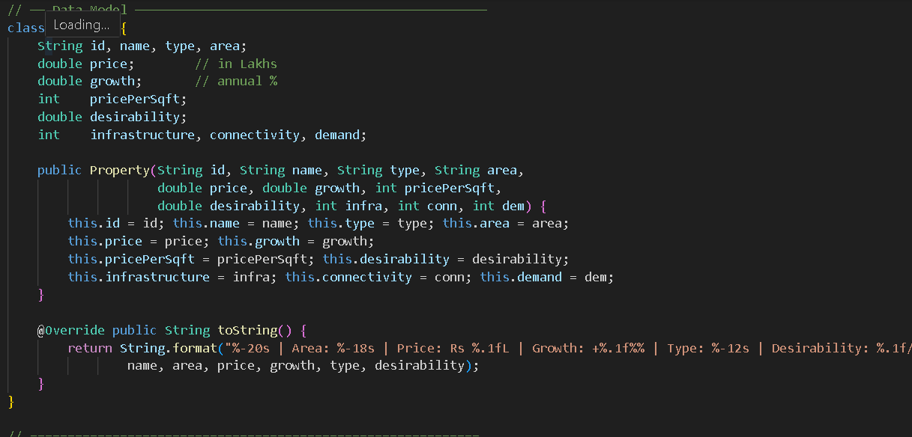
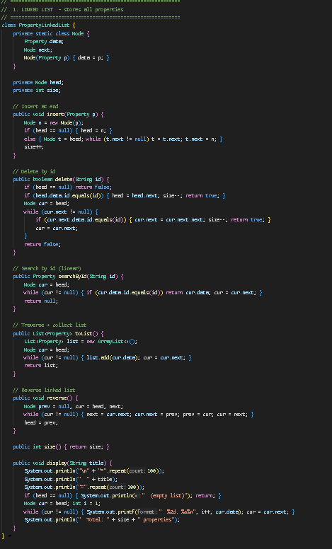
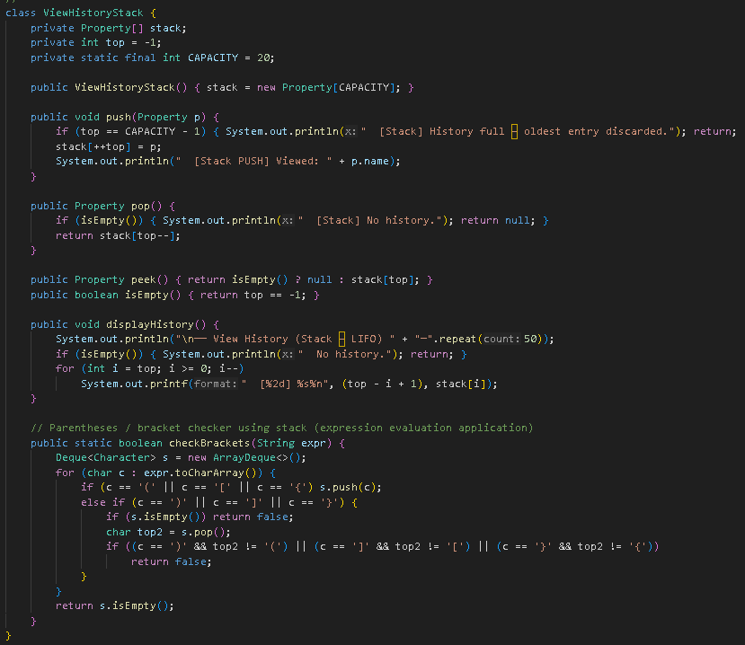
DSA SCREENSHOTS

Slide 14
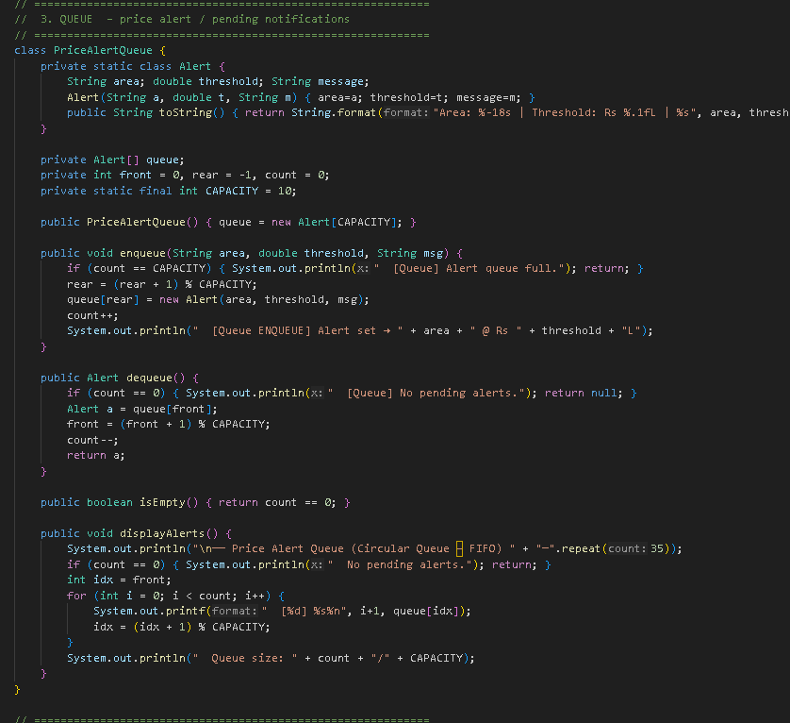
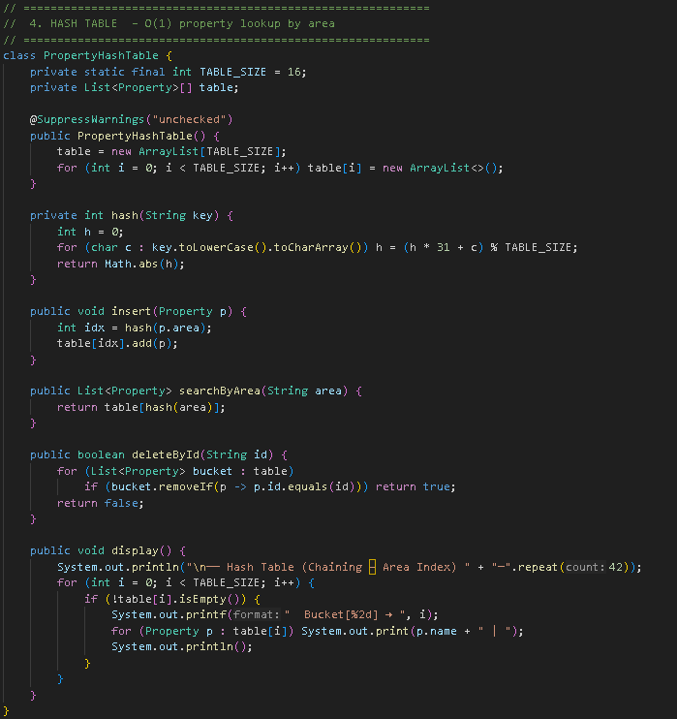
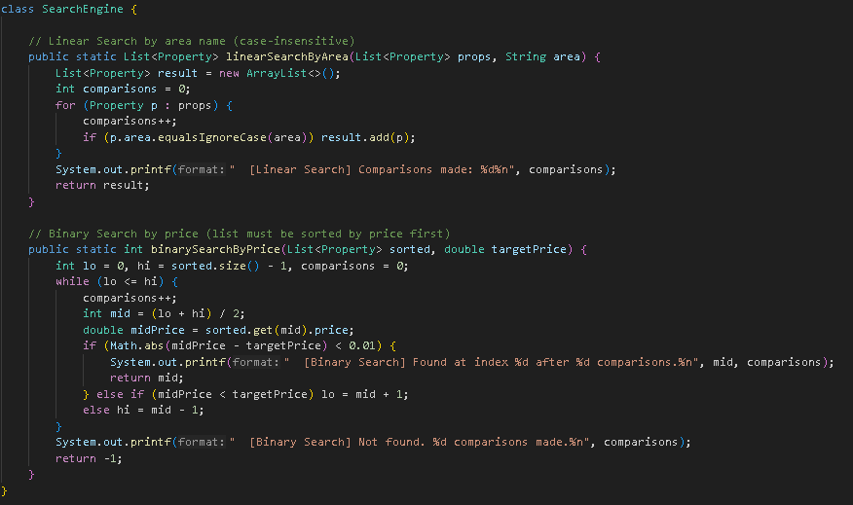

Slide 15
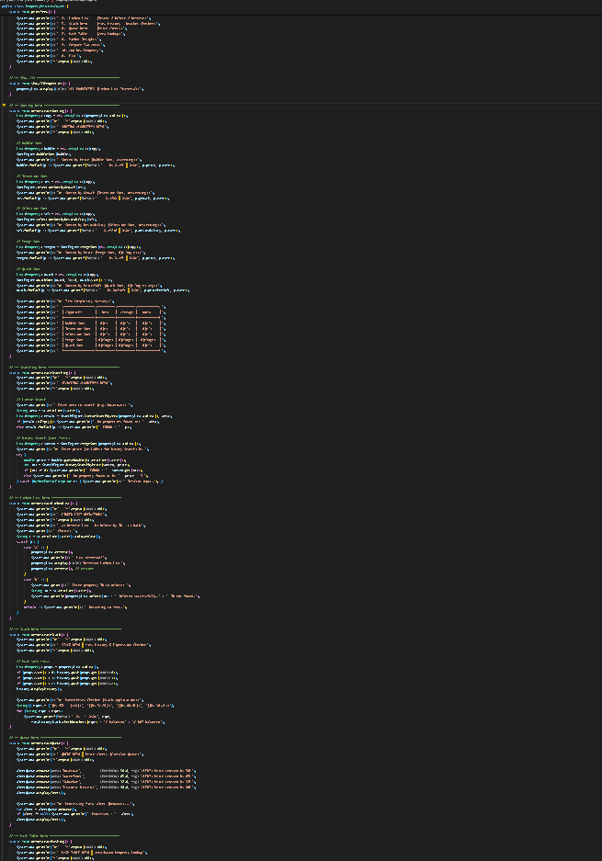
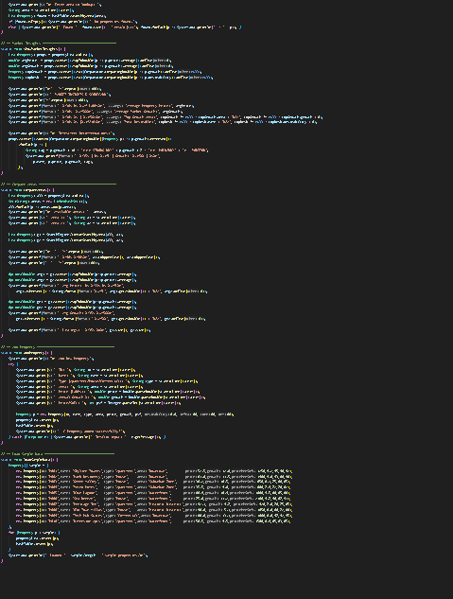
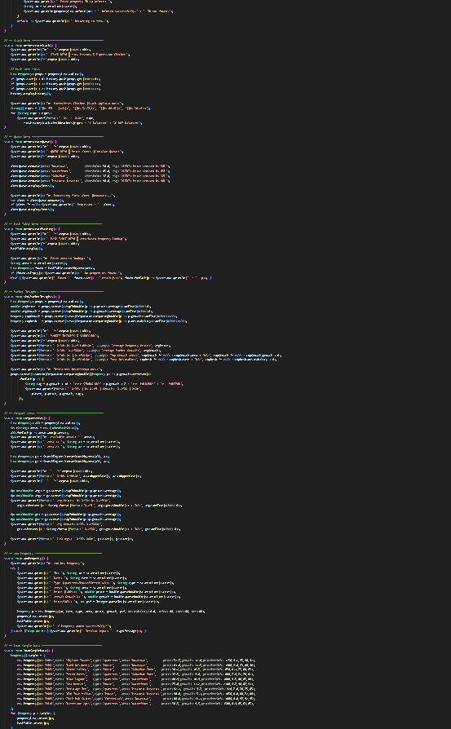

Slide 16
Conclusion
The Property Price Trend Area Insights system provides a powerful platform for analyzing real estate market trends. By combining data visualization, area comparison, and market insights, the system helps users understand property price movements and identify profitable investment opportunities. The use of charts, filters, and analysis tools makes the system interactive and easy to use for both investors and home buyers.
Overall, this project demonstrates how web technologies and data analysis can be used together to solve real-world problems in the real estate sector.

Slide 17
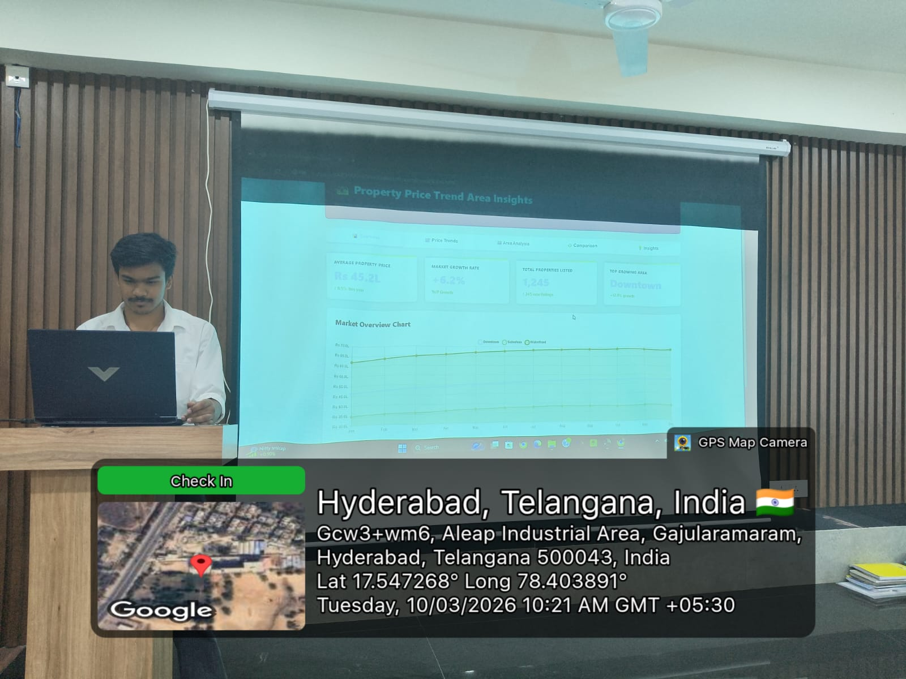
Geo- Tag Photos

Slide 18
THANK YOU

